Slide 1
MOT1421 Economic Foundations Week 1: The Neoclassical theory of demand (continued)
Question:
What happens to ‘optimal consumption’ when the price of (say) good 1 decreases?
Answer:
In the case of a ‘normal’ good, the demand for good 1 increases -> “The Law of Demand” holds.
See PP-slide 3.

Slide 2
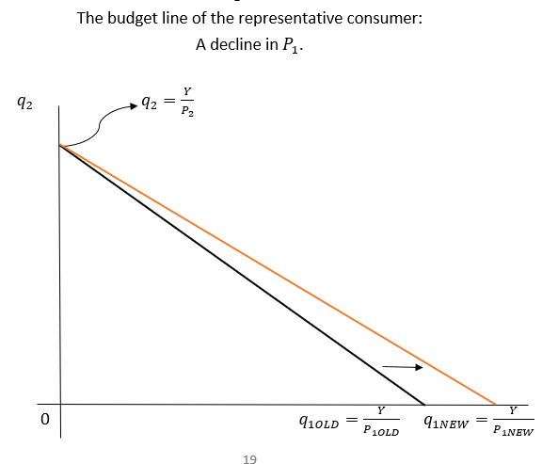
MOT1421 Economic Foundations Week 1: The Neoclassical theory of demand
Suppose P₁
declines.
What
happens to the
budget constraint?

Slide 3
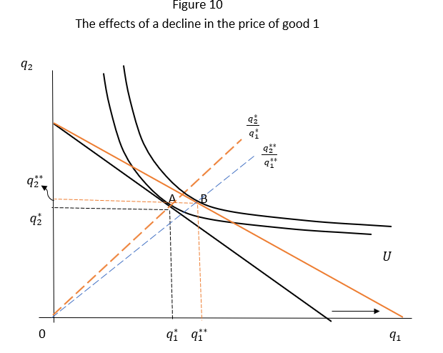
MOT1421 Economic Foundations The Neoclassical theory of demand
Experiment:
a decline in the
price of good 1
-> total effect
is the shift from A
to B ...........

Slide 4
MOT1421 Economic Foundations The Neoclassical theory of demand
The total effect (moving from A to B) means:
Consumption of good 1 increases from q1* to q1** ( + )
Consumption of good 2 increases from q2* to q2** ( + )
The Total Effect for good 1 can be DECOMPOSED into:
A substitution effect (along the original indifference curve)
An income effect (“jumping” from the original to the new indifference curve).
NOTE: the income effect = the total effect – the substitution effect

Slide 5
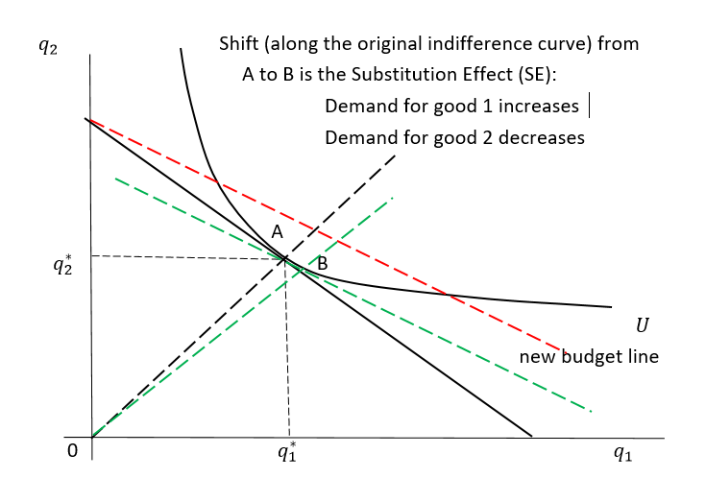
MOT1421 Economic Foundations
Determining
the substitution
effect (SE) of
a decline in P1

Slide 6
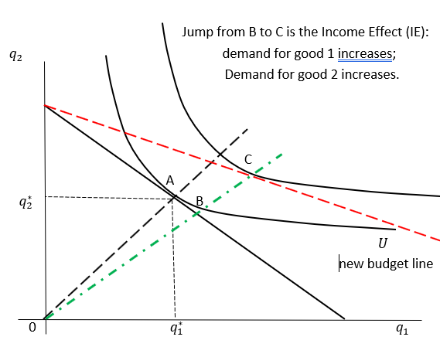
MOT1421 Economic Foundations
Determining the
income effect
(IE) of
a decline in P1

Slide 7
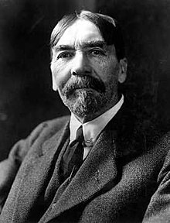
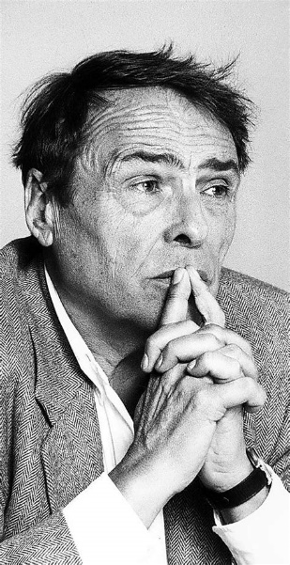
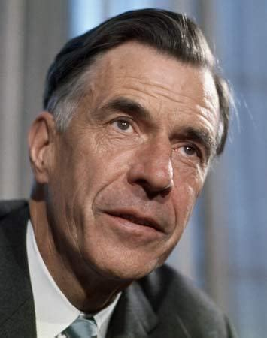
MOT1421 Economic Foundations Week 1: Remaining topics
Price and income elasticities of demand
Giffen good
Alternative theories of consumer demand:
Thorstein Veblen (left)
Pierre Bourdieu (centre)
John Kenneth Galbraith (right)

Slide 8
MOT1421 Economic Foundations Week 1: The demand function
The demand for good X is (in general) a function of the following variables: D_{x} = f (Y, P_{x}, P_{z})
Consumer income Y (see Figure 1 in the Lecture Note)
The price of commodity X
The price of substitute good Z
Exogenous consumer preferences
All other (non-economic) factors: geography; climate; culture; season; etc.

Slide 9

MOT1421 Economic Foundations Week 1: the income elasticity of demand
The income elasticity of demand e_{Y} is defined as the proportionate change in the quantity (q) demanded of a particular good or service, resulting from a proportionate change in the income (Y) of consumers.
In symbols, we may write:
Example: suppose e_{Y} = ½ -> an increase in income by 10% will increase demand for this commodity by 5%.

Slide 10
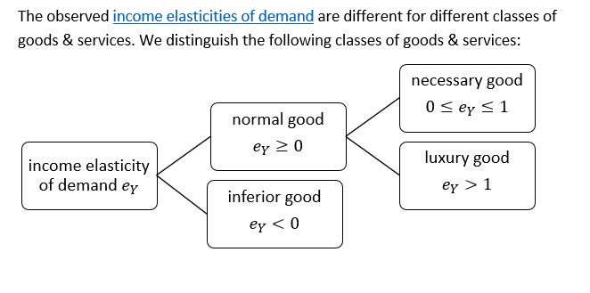
MOT1421 Economic Foundations Week 1: the income elasticity of demand

Slide 11
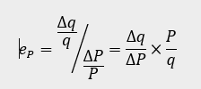
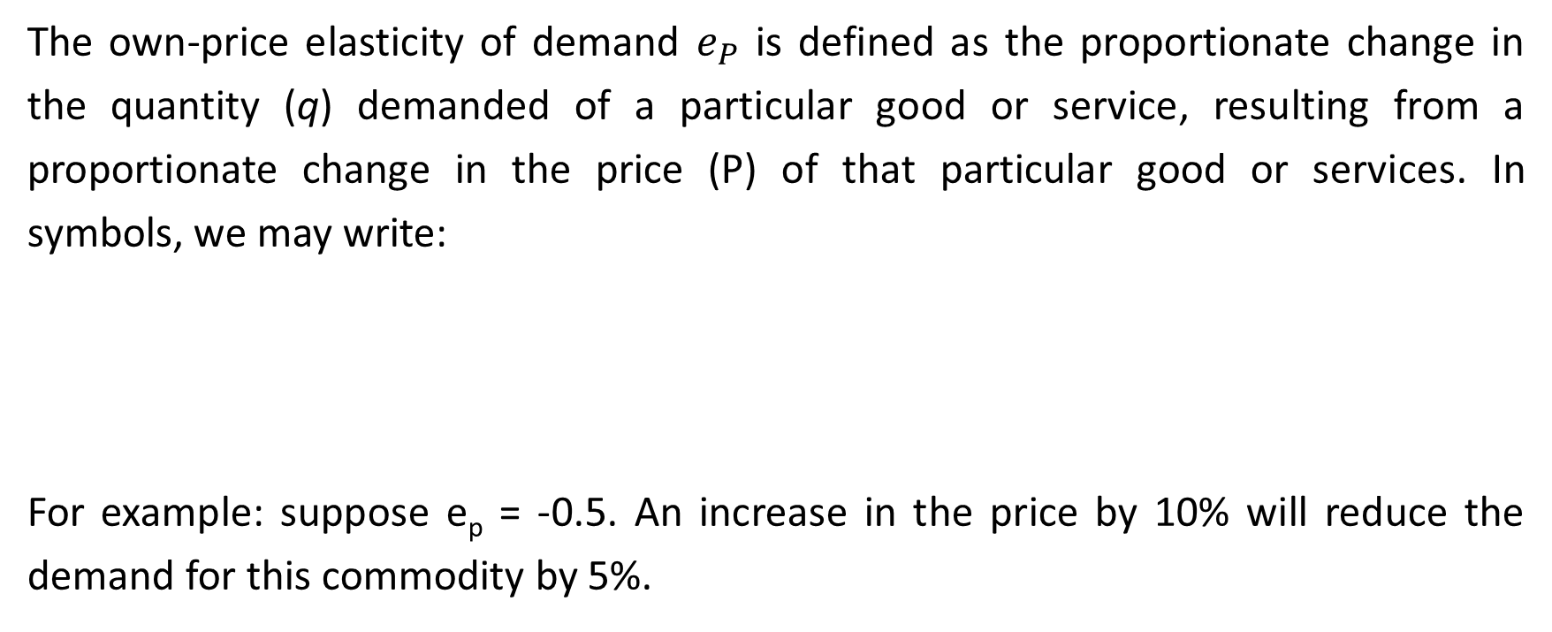
MOT1421 Economic Foundations Week 1: the own price-elasticity of demand
The own-price elasticity of demand $e_{P}$ is defined as the proportionate change in the quantity (q) demanded of a particular good or service, resulting from a proportionate change in the price (P) of that particular good or services. In symbols, we may write:
For example: suppose e_{p} = -0.5. An increase in the price by 10% will reduce the demand for this commodity by 5%.

Slide 12
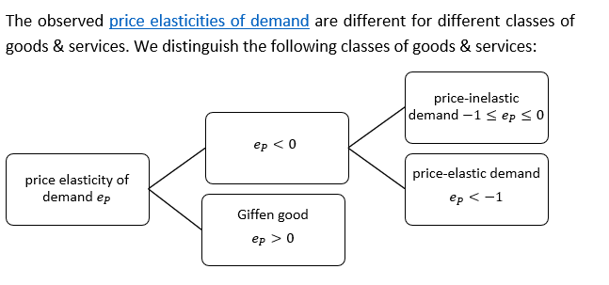
MOT1421 Economic Foundations Week 1

Slide 13
MOT1421 Economic Foundations Week 1: Giffen goods
Giffen goods are goods for which the demand increases when their prices increase. (This not consistent with the “Law of Demand”).
Suppose the price of good X rises. We know that the substitution effect is negative: utility-maximising consumers will reduce the consumption of good X.
But because we know (from observation) that the demand for good X increases in response to the higher price, it follows that the income elasticity of demand for good X is negative (“inferior” goods). Why?
The higher price for good X lowers real income of the consumers. (Real) incomes go down.
Nevertheless, demand for good X rises → a negative income elasticity of demand.

Slide 14
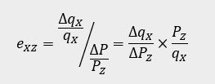
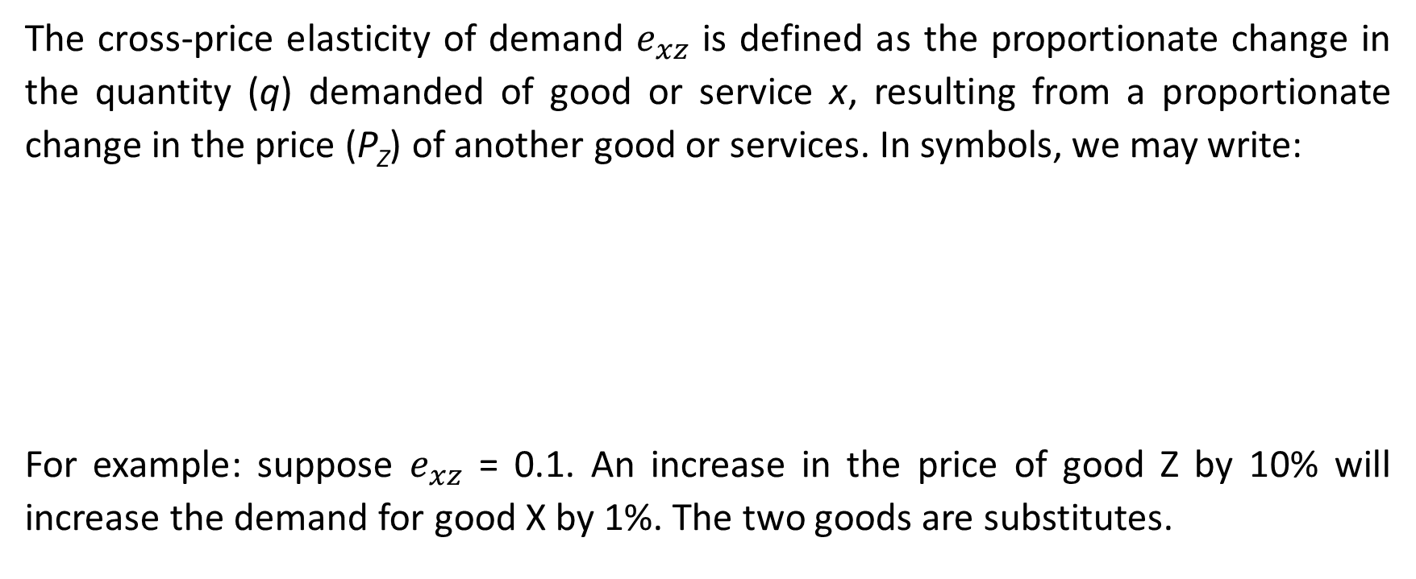
MOT1421 Economic Foundations Week 1: the cross-price elasticity of demand
The cross-price elasticity of demand $e_{xz}$ is defined as the proportionate change in the quantity (q) demanded of good or service x, resulting from a proportionate change in the price (P_{Z}) of another good or services. In symbols, we may write:
For example: suppose $e_{xz}$ = 0.1. An increase in the price of good Z by 10% will increase the demand for good X by 1%. The two goods are substitutes.

Slide 15
MOT1421 Economic Foundations Week 1: Institutionalist theories of consumer behaviour
Thorstein Veblen (left)
Pierre Bourdieu (centre)
John Kenneth Galbraith (right)

Slide 16
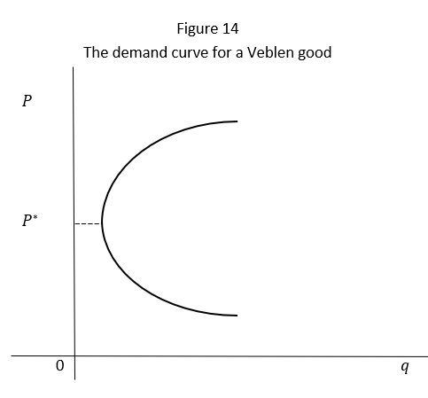
MOT1421 Economic Foundations Week 1: Veblen goods
Consumption is (partly) motivated by status considerations – to “show off” (“The Theory of the Leisure Class, 1899).
The consumption norms of the leisure class are mostly wasteful,
useless and non-productive, meant to show off one’s wealth.
Veblen calls it conspicuous consumption.
The lower income-classes emulate the consumption norms and habits
of the leisure class, to the extent they can afford and within their
own (lower) budgets. This kind of status consumption leads to
the existence of so-called Veblen goods (positional goods).

Slide 17
MOT1421 Economic Foundations Week 1: Consumption = investment in cultural capital (Bourdieu)
For Bourdieu,
all individuals wish to belong to a particular socio-economic class;
each socio-economic class distinguishes itself from other classes by its consumption decisions (distinction); and therefore:
to belong to a particular social class, the individual has to acquire the cultural capital that characterises that particular class by cultivating its consumption norms and habits.
Result: preferences are endogenous, determined/influenced by social norms.

Slide 18

MOT1421 Economic Foundations Week 1: Consumption = investment in cultural capital (Bourdieu)
Typical Dutch cultural capital:

Slide 19
MOT1421 Economic Foundations Week 1: Want creation (J.K. Galbraith)
Oligopolistic firms compete by (product) innovation,
and hence, these firms try to create demand for their new products by manipulating/influencing preferences.
U.S. firms are spending on advertising and marketing is around 2.5% of U.S. GDP – or around U.S. $ 530 billion in 2019. This is more than one-third of what the U.S. are spending on education which is 6.5% of GDP.
Result: consumer preferences are endogenous and can be manipulated by firms. Producers (rather than consumers) are sovereign.

Slide 20

MOT1421 Economic Foundations Week 1: Want creation (J.K. Galbraith)

